Slide 1
Number System

Slide 2
Analog vs Digital
Analog signal are time varying.
Analog devices accepts value across a continuous range.
Digital signal is modeled as accepting only one of two discrete values: High ‘1’ or Low ‘0’
Most common digital devices are Logic gate, Flip Flop

Slide 3
Analog vs Digital
Digital devices preferred over Analog
Higher accuracy
Less affected by noise
Have memory
Design is much easier
More reliability
Digital display can be obtained
Ease of design
Programmability
Processing speed
Cost efficient/ Economical
Steadily advanced technology
Communication between digital systems is much easier

Slide 4
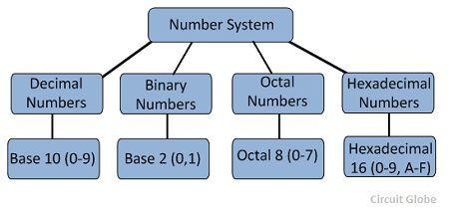
Number System and Code
Digital systems process binary digits 0 and 1
Base 10 is important for everyday business.
Base 2 is important for processing of digital circuit.
Base 8 and Base 16 provide convenient shortened representation for multibit number in a digital system.

Slide 5
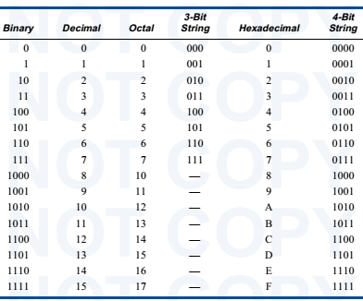
Equivalent Number

Slide 6
Quiz Time
Base of Radix of Hexadecimal Number System is:
2
8
10
16
Notes:
D

Slide 7
Grouping of Bits
Individual binary digit → Bit
Group of 4 bits → Nibble
Group of 8 bits →2 Nibble → Byte
Group of 16 bits → 2 Bytes →4 Nibbles → Word
Group of 32 bits → 2 Words→ 4 Bytes → 8 Nibbles → Doubleword
Group of 64 bits → 2 Doublewords → 4 Words →8 Bytes → 16 Nibbles → Quadword

Slide 8
Quiz Time
How many nibble in the given number
Q=101110010101
1
2
3
4
Notes:
C

Slide 9
Number & Number system
A number is a method used for representing an arithmetic value, measure, or count, of a physical quantity. A number system is defined as a method of naming and representing numbers. The concept of number system helps in defining the rules associated with the numbers and different operations on numbers.
A number system is determined with the help of its radix or base. The radix or base of a number system is nothing but the total number of symbols used in the number system for representing the different numbers. For example, in the decimal number system, there are 10 symbols, i.e. 0, 1, 2, 3, 4, 5, 6, 7, 8, 9. Thus, the base or radix of the decimal number system is 10.

Slide 10
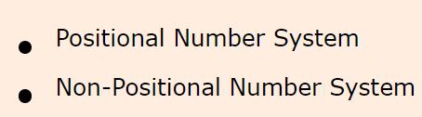
Categories of number systems

Slide 11
Positional Number System
Positional number system is the type of number system in which the weight or value of the digit (or symbol) depends upon its position in the number. The positional number system is also known as weighted number system. This is because, in the positional number system, there is a weight associated with the position in the number.
Therefore, in the positional number system, each digit of the number is weighted according to its position of occurrence in the number. When we travel toward left along the number, the weights increase by a constant factor that is equivalent to the base of the number system. Also, in the positional number system, a radix point (.) is used to differentiate the positions corresponding to integral weights from the positions corresponding to the fractional weights.

Slide 12
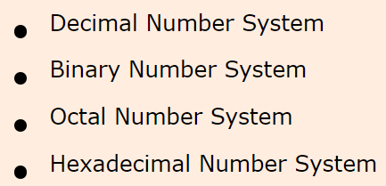
Types of Positional Number Systems
There are four very popular positional number systems:

Slide 13
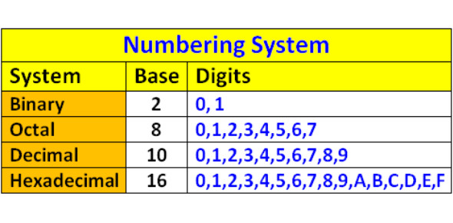

Slide 14
Decimal Number System
The decimal number system is the most familiar number system for us. It is called decimal number system because its base or radix is ten (10). This means, it has 10 unique symbols, i.e. 0, 1, 2, 3, 4, 5, 6, 7, 8, and 9 to represent different numbers of the system. Also, there is no symbol for its base, i.e. for ten.
In the decimal number system, any number, whether it is an integer or fraction or mixed number, of any magnitude can be represented by using these ten symbols only. Each of these symbols is called a digit.

Slide 15
In a decimal number, the most left digit has the greatest positional weight out of all the digits present in the number, this is called the MSD (Most Significant Digit). On the other hand, the right most digit has the least positional weight out of all the digits present in the number, it is called LSD (Least Significant Digit).

Slide 16
In the decimal number system, the digits present on the left of the decimal point form the integral part of the decimal number, while the digits present on the right of the decimal point form the fractional part of the number. The digits in the integral part of the decimal number have weights that are positive powers of 10 (base), whereas, the digits in the fractional part of the decimal number have weights that are negative powers of 10.

Slide 17
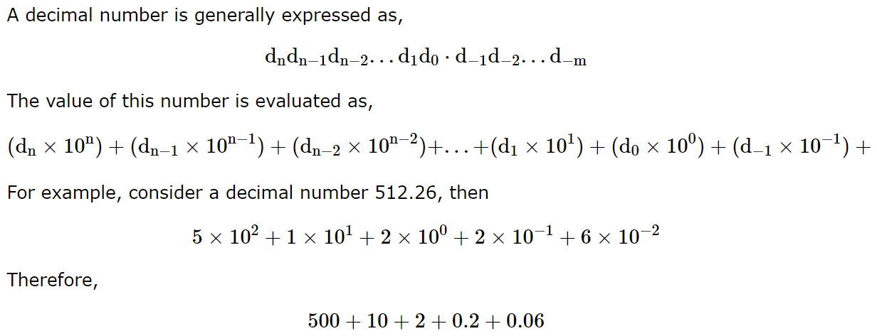

Slide 19
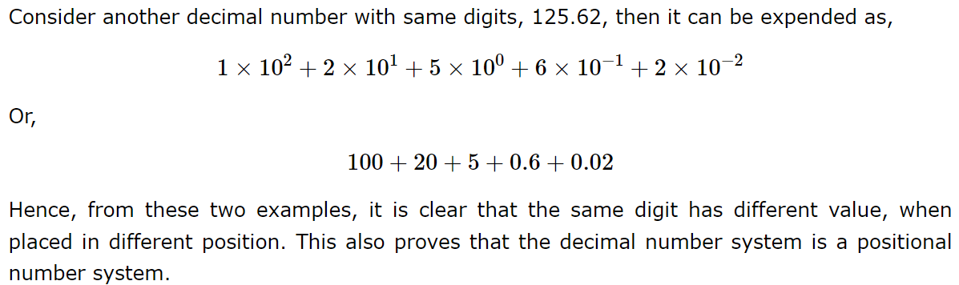

Slide 20
Binary Number System
The binary number system is also a positional number system or a weighted number system. The base or radix of the binary number system is 2, which means it has two unique symbols, i.e. 0 and 1 to represent numbers. Similar to decimal number system, the base of the binary number system itself cannot be a symbol.
In the binary number system, each digit is called a bit (binary digit). Thus, a binary number is nothing but a string of binary 0s and 1s. There is a binary point (radix point) that separates the integral and fractional parts of the binary number. Each binary digit or bit in a binary number carries a weight according to its position with respect to the binary point.

Slide 21
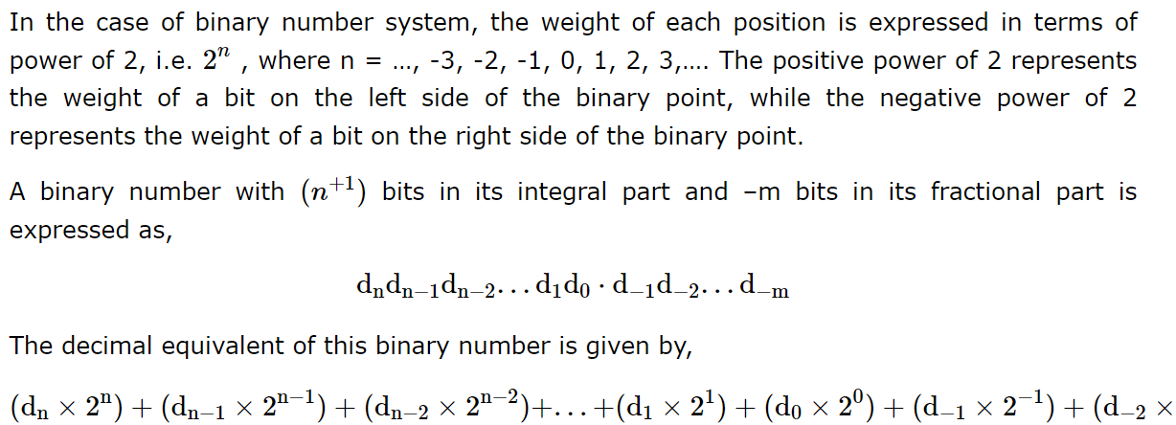

Slide 22
The binary number system is mainly used in digital systems because digitals systems use two state switching devices like diodes, transistors, etc. Where, the binary 1 is used to represent the ON state of the device, and the binary 0 is used to represent the OFF state of the device.

Slide 23
Octal Number System
Octal Number System is again a type of positional number system. That means, the value of a digit in an octal number depends upon its position in the number. The base or radix of the octal number system is 8, thus, the octal number system has eight unique symbols, i.e. 0, 1, 2, 3, 4, 5, 6, and 7. The octal number system was widely used in early minicomputers.

Slide 24
Hexadecimal Number System
The hexadecimal number system is also a type of positional or weighted number system. The base or radix of the hexadecimal number system is 16, which means there are sixteen independent symbols present in this system. These symbols are 0, 1, 2, 3, 4, 5, 6, 7, 8, 9, A, B, C, D, E, and F. All the numbers in hexadecimal number system can be expressed using these symbols

Slide 25
Number conversion
Methods or techniques used to convert numbers from one base to another.
Decimal to Other
Step 1 − Divide the decimal number to be converted by the value of the other base.
Step 2 − Get the remainder from Step 1 as (least significant digit) of new base number.
Step 3 − Divide the quotient of the previous divide by the new base.
Step 4 − Record the remainder from Step 3 as the next digit.
Repeat Steps 3 and 4, getting remainders until the quotient becomes zero
The last remainder thus obtained will be the Most Significant bit(MSB) of the new base number.

Slide 26
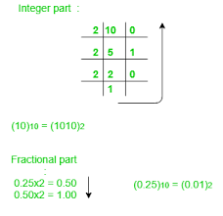
Number conversion
Decimal to Binary
10 to binary
0.25 to binary

Slide 27
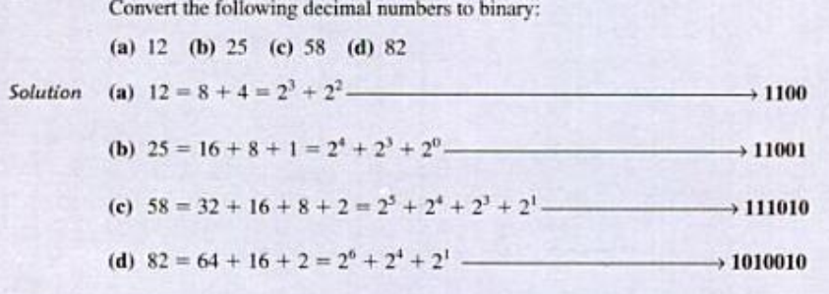
Decimal to Binary

Slide 28
Decimal to Binary

Slide 29
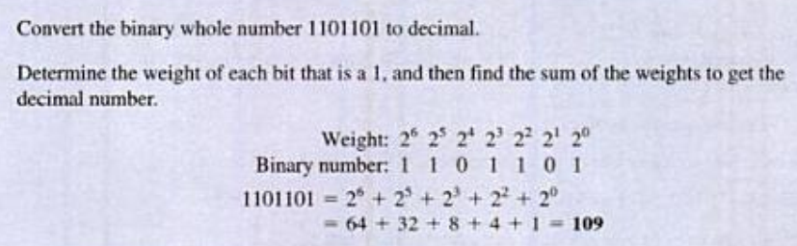
Binary to Decimal Conversion

Slide 30
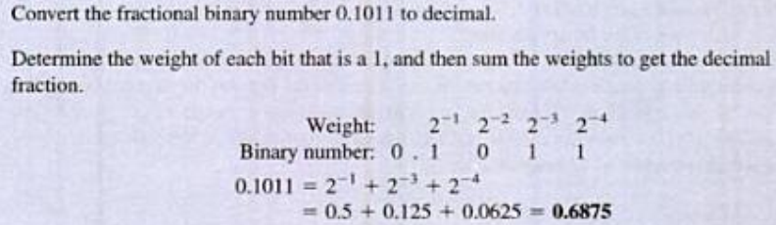
Binary to Decimal Conversion

Slide 31
Quiz Time
Representation of Octal number requires ______ bits and Hexadecimal number requires ____bits.
2,3
3,4
1,3
8,16
Notes:
B

Slide 32
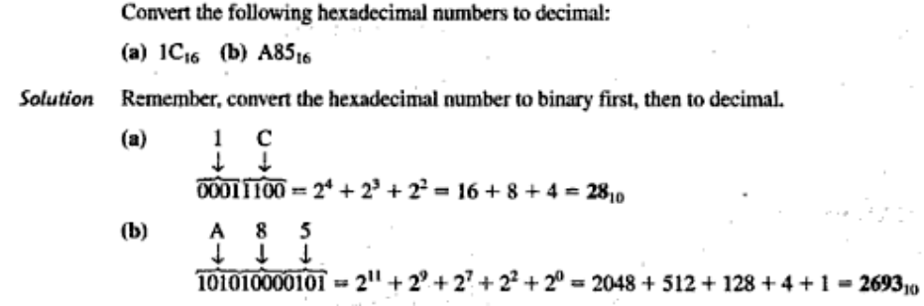
HexaDecimal to Decimal Conversion

Slide 33
Decimal to HexaDecimal Conversion

Slide 34
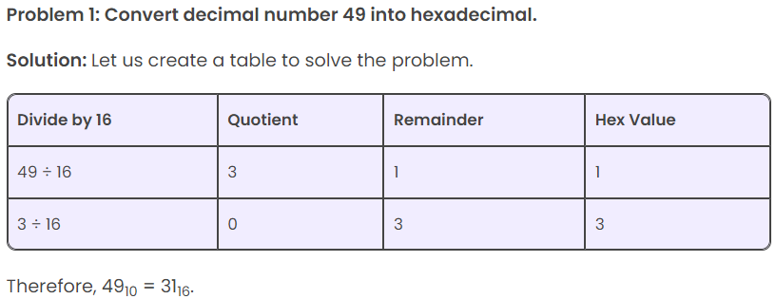

Slide 35
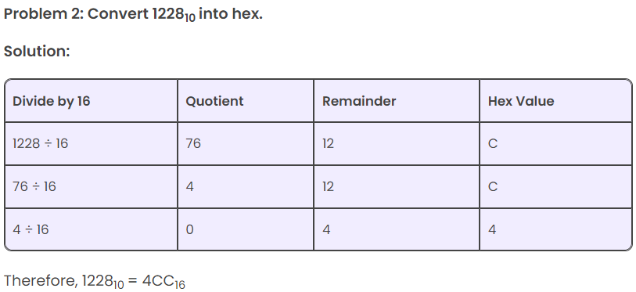

Slide 36
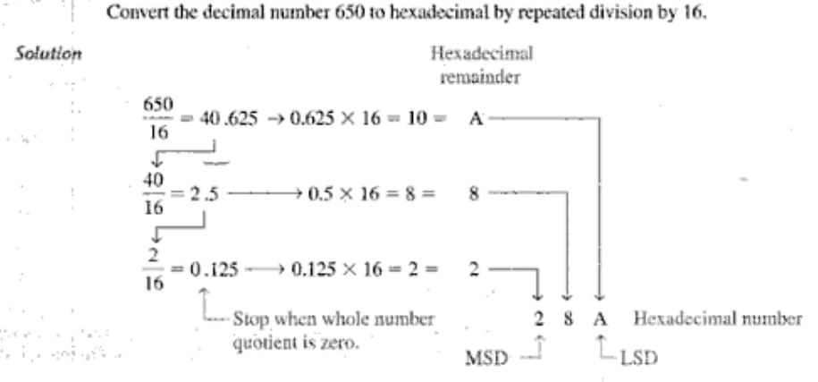


Slide 37
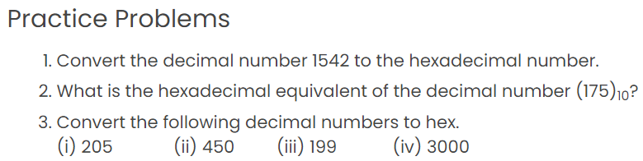

Slide 38
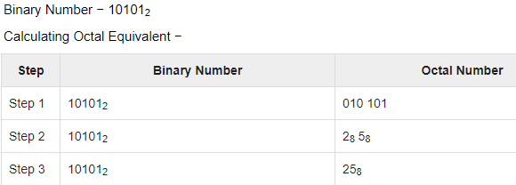
Binary to Octal
Step 1 − Divide the binary digits into groups of three (starting from the right).
Step 2 − Convert each group of three binary digits to one octal digit.

Slide 39
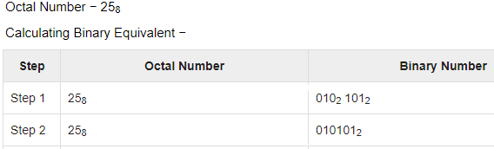
Octal to Binary
Step 1 − Convert each octal digit to a 3 digit binary number.
Step 2 − All the resulting binary groups (of 3 digits each) into a single binary number

Slide 40
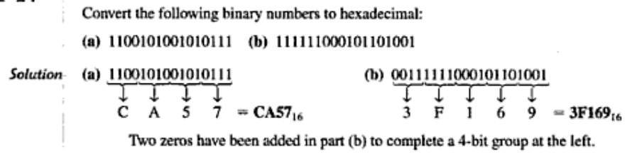
Binary to Hexadecimal Conversion
Step 1 − Divide the binary digits into groups of four (starting from the right).
Step 2 − Convert each group of three binary digits to one hexa digit.

Slide 41
Binary to Hexadecimal Conversion
Step 1 − Divide the binary digits into groups of four (starting from the right).
Step 2 − Convert each group of three binary digits to one hexa digit.

Slide 42
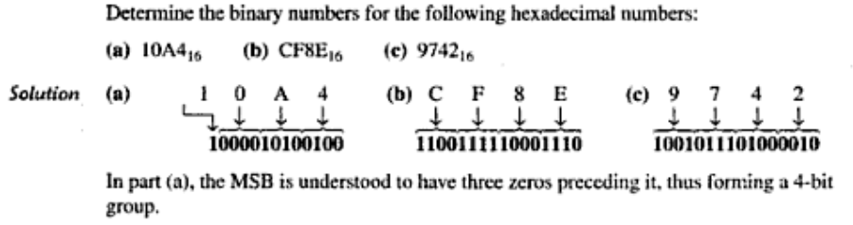
Hexadecimal to Binary
Step 1 − Convert each hexa digit to a 4 digit binary number.
Step 2 − All the resulting binary groups (of 4 digits each) into a single binary number

Slide 43
Hexadecimal to Binary
Step 1 − Convert each hexa digit to a 4 digit binary number.
Step 2 − All the resulting binary groups (of 4 digits each) into a single binary number

Slide 44
Quiz Time
Convert the binary number 1001.0010₂ to decimal.
9.125
9.25
9.5
9.2
Notes:
A

